Slide 1
Mechanics Map Homework Problem Diagrams

Slide 2
3m
d
50 kg
P

Slide 3
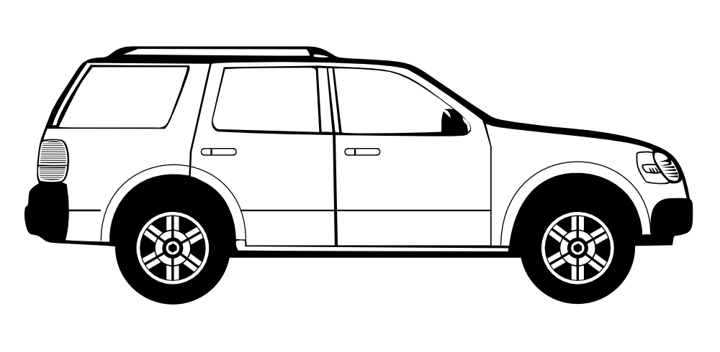
4 ft
4 ft
G
2.5 ft

Slide 4

B
A
30º
5º

Slide 5
30 kg
A
60º
B
30º

Slide 6
y
20º
A
.25 kg
B
20º
x

Slide 7
T₁
T₂
15º
25º

Slide 8
3m
d
50 kg
P

Slide 9
32º
38º
12º
A = ?
B = 60lbs

Slide 10
B
100 kg
A
100 kg
C
100 kg
45º
30º

Slide 11
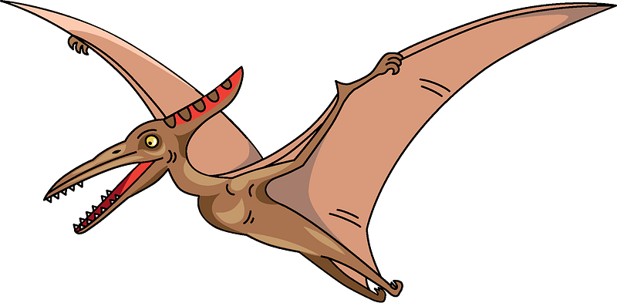
T_{B}
T_{A}
y
30º
T_{C}
25º
x
30º
20º
z

Slide 12
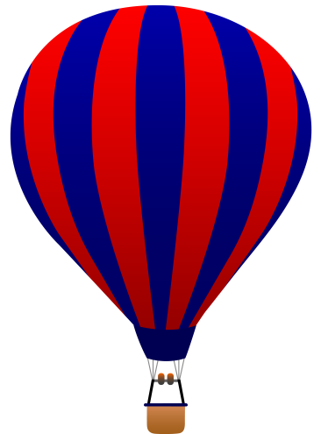
y
900 lbs
30 ft
C
10 ft
20 ft
30 ft
35 ft
x
A
20 ft
B
z

Slide 13


$$T= ?$$
A
35º
B
9 in
9 in
$$F_{g}=60 lbs$$

Slide 14
4m
A
B
2m
25º
6 kN

Slide 15
F_{A}
F_{B}
30º
12 in
48 in
12 in
36 in
O

Slide 16
T_{C} = 50 N
C
T_{A} = 50 N
Z
Y
T_{B} = 100 N
6 m
X
O
A
3 m
8 m
B

Slide 17
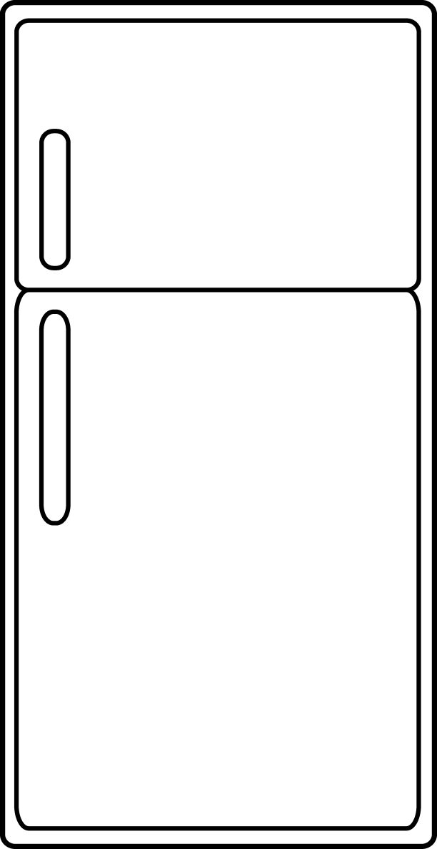
COM
50 lbs
3 ft
2 ft
1.5 ft
1.5 ft

Slide 18
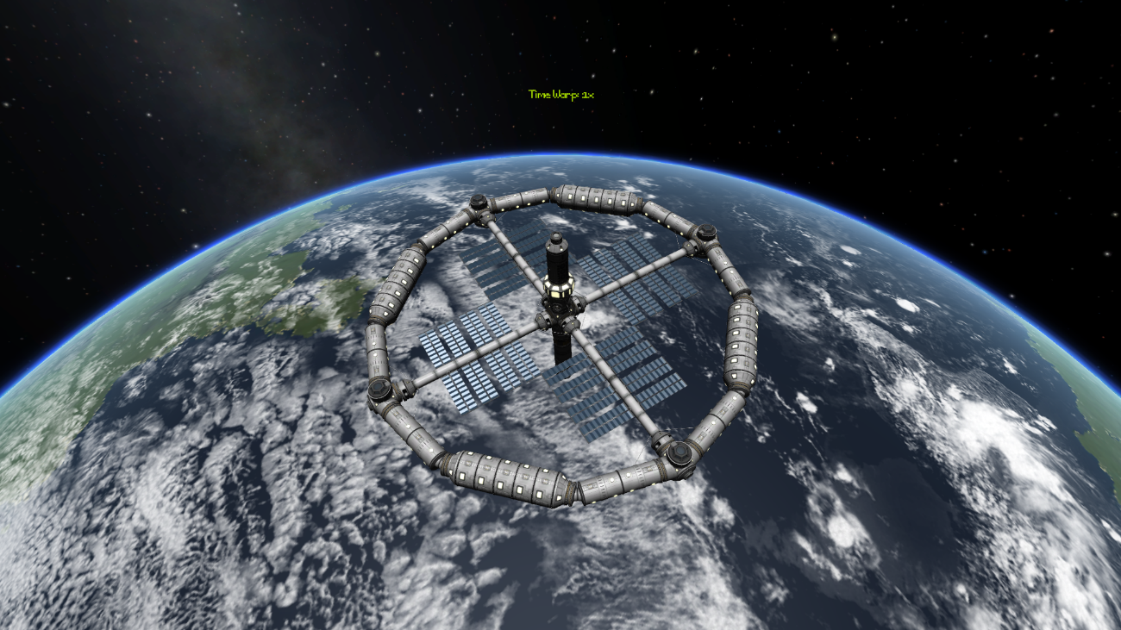
F_{thruster}
F_{thruster}

Slide 19
y
30 cm
F_{z}
O
x
F_{y}
40º
25 cm
z
60 N

Slide 20
y
32.5 in
40 in
P=800 lbs
O
x
27.5 in
35 in
z

Slide 21
F = 150 lbs
2 ft
6 ft
A
B

Slide 22
F = 150 lbs
2 ft
6 ft
A
B

Slide 23
C
5m
T
B
400 kg
5m
40º
A

Slide 24
F_{L} = 120 lbs
F_{G} = 50 lbs
2 ft
4 ft
60º

Slide 25
4 ft
2 ft
G
2 ft

Slide 26
38º
G
B
1m
1m
A
2m
1.5m
2m
30º

Slide 27
T_{C}
T_{A}
12 ft
4 ft
Z
Y
8 ft
T_{B}
X

Slide 28
y
3 m
B
3 m
A
z
C
x
2 m
4 m
6 m
1 m

Slide 29
60 lbs
40 lbs
3 ft
5 ft
5 ft
100 lbs
2 ft
8 ft

Slide 30









$$200 N$$
$$100 N$$
A
B
30 cm
30 cm
30 cm
15 cm
30 cm
30 cm
$$30 Nm$$
30 cm
30 cm
$$200 N$$
$$200 N$$
$$200 N$$
$$200 N$$
$$100 N$$
$$200 N$$

Slide 31
F = 150 N
3 m
5m
A

Slide 32
60 lbs
25º
60 lbs
60 lbs
3 ft
A
5 ft
2 ft

Slide 33
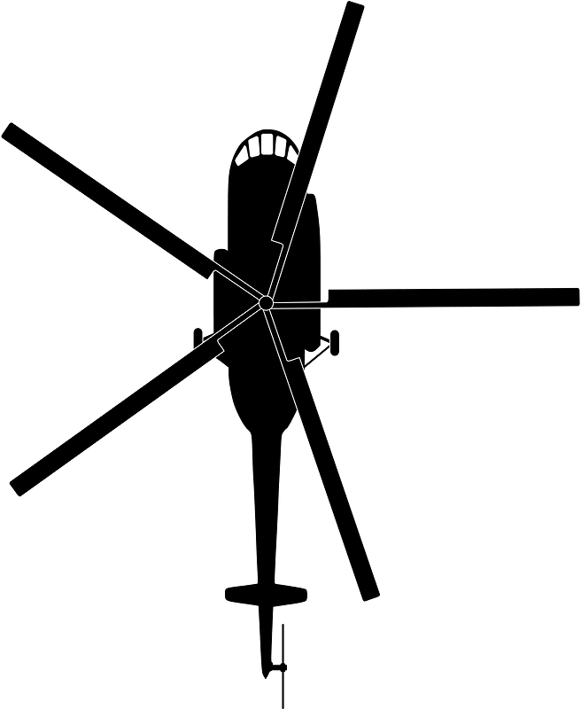



$$F_{W}=300 N$$
55º
C
$$M_{B}=3 kNm$$
5 m
$$F_{R}=650 N$$

Slide 34
50 N/m
20 N/m
2 m
3 m

Slide 35

$$600 lbs / foot$$
6 ft
12 ft

Slide 36
3 kN / m
1.5 m
2 m
2.5 m

Slide 37
4 m
8 m
B
4 m
A
C
D
40 kN

Slide 38
A
C
E
2 ft
B
D
F
10 ft
10 ft
60 lbs
120 lbs

Slide 39
A
B
30º
D
25º
C
3 m
3 m
600 N

Slide 40
5 ft
10 ft
5 ft
A
C
5 ft
20º
B
D
5 ft
6000 lbs
Design 1

Slide 41
5 ft
10 ft
5 ft
A
C
5 ft
20º
B
D
5 ft
6000 lbs
Design 2

Slide 42
14 kN
3 m
3 m
3 m
A
C
E
G
2 m
F
1 m
B
D

Slide 43
4 ft
4 ft
4 ft
4 ft
4 ft
4 ft
A
B
C
3 ft
D
E
3 ft
F
G
H
6 ft
400 lbs
400 lbs
800 lbs

Slide 44
50 lbs
1 ft
1 ft
A
C
D
.5 ft
B

Slide 45
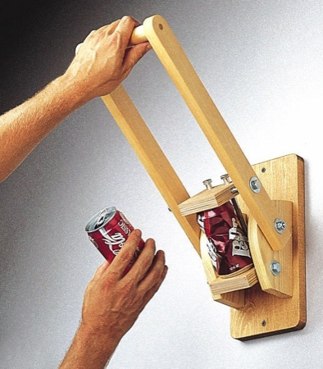

A
.3 m
B
.1 m
20 N
25º
C
.1 m
D

Slide 46

10 cm
A
20 cm
B
C
40 cm
D
E
F
40 cm
10 cm
20 cm
3300 N

Slide 47
30 lbs
A
4 in
4 in
150 lbs
18 in
80º
B
C
D
6 in
E
12 in
F
G
8 in

Slide 48
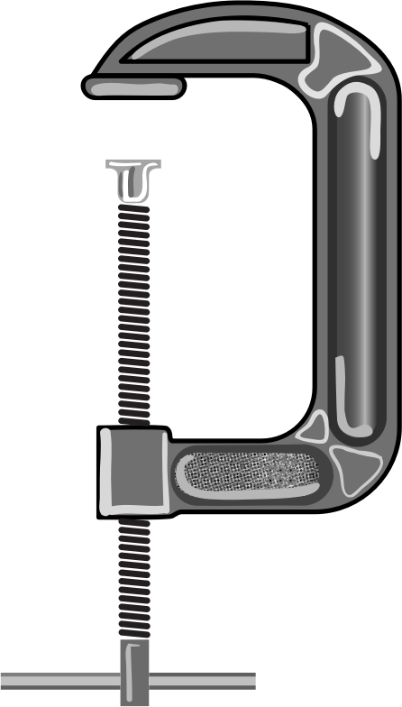
5 in
60 lbs
4 in
60 lbs
a
a
6 in

Slide 49
3 m
50º
7 kN
4 m
a
a
Lucky Catch

Slide 50
A
10 kN
B
5 kN
C
10 kN
D
F_{N}

Slide 51
A
B
C
D
350 ft lbs
150 ft lbs
100 ft lbs
100 ft lbs
18 in
12 in
12 in

Slide 52
A
B
C
D
E
4 m
4 m
2 m
3 m
4 kN
3 kN /m

Slide 53
6 ft
4 ft
6 ft
30 lbs /ft

Slide 54
$$F$$
30º

Slide 55
$$F_{pull}$$
m = 60 kg
25º

Slide 56
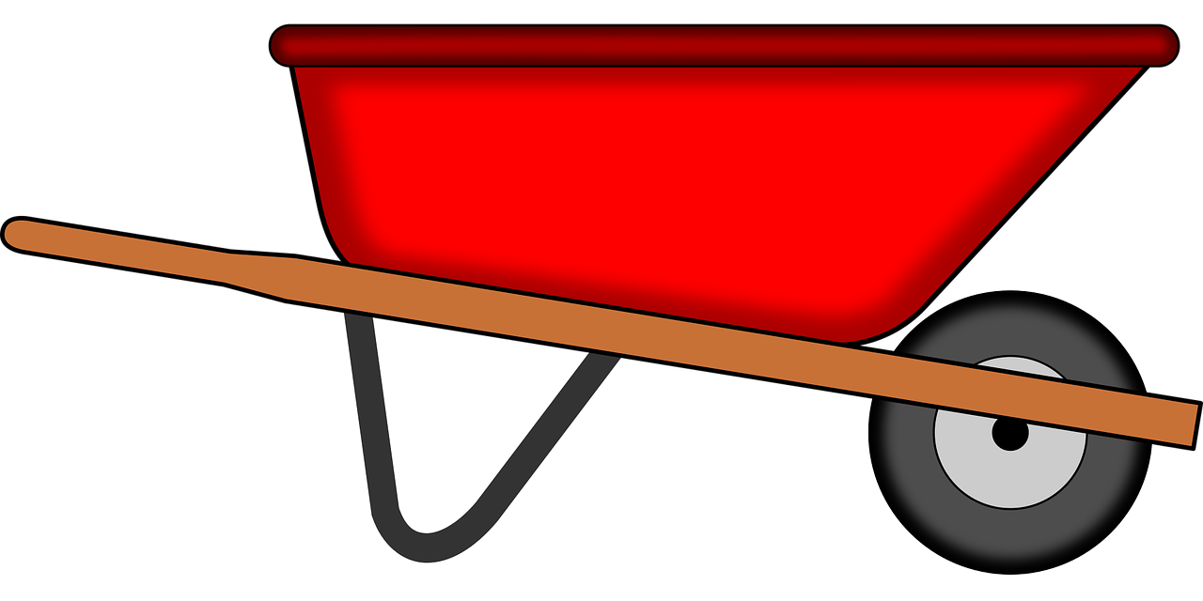
24 in
12 in
G
18 in
B
A

Slide 57
G
$$F_{push}$$
3 ft
2 ft
1.5 ft
1.5 ft

Slide 58
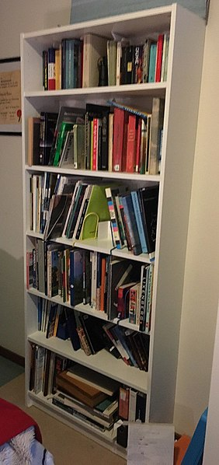


$$120 lbs$$
2.5 ft
G
30º
2.5 ft
$$F_{pull}$$
2 ft
1 ft
Image by Nathan Kramer
CC-BY-SA 4.0

Slide 59
200 lbs
8º

Slide 60
4000 lbs

Slide 61
$$F_{Load}=300N$$
End Bearing

Slide 62
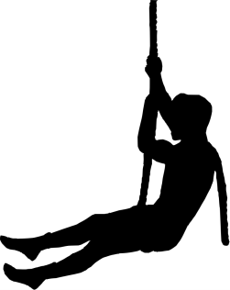
45º
$$F_{pull}$$

Slide 63

30 m

Slide 64
60 s
180 s
210 s
.5 m/s²
Acceleration
(m/s²)
Time
(s)
-1 m/s²

Slide 65
3 s
4 s
7 s
9 ft/s
3 ft/s
Velocity
(ft/s)
Time
(s)

Slide 66
10 ft
v_{i} = ?
40º
25 ft

Slide 67
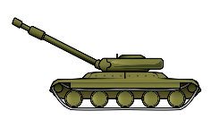
d
V_{o}=600m/s
30º
30º
1000 m

Slide 68

t
a = 40 ft/s²
35º
n

Slide 69


v_{i} = 25 m/s
a_{t} = - 4 m/s²

Slide 70



t₂
t₁
r₂= 5947 m
y
r₁= 5900 m
$$θ_{2}=\text{63}\text{o}$$
x
$$θ_{1}=\text{61}\text{o}$$

Slide 71


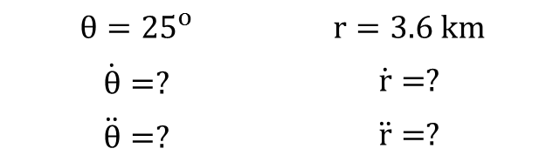


$$θ={25}^{o}$$ | $$r=3.6 km$$
$$\dot{θ}=?$$ | $$\dot{r}=?$$
$$\ddot{θ}=?$$ | $$\ddot{r}=?$$
v = 400 m/s
a = 3 m/s²
70º
y
$$r$$
$$θ$$
x

Slide 72



$$x_{B}$$
$$x_{A}$$
$$v = 2 ft/s$$

Slide 73
2 m
2 m
A
C
h
v = .5 m/s
B

Slide 74



$$v_{R/C}=?$$
$$v_{R/O}=?$$
35º
$$v_{C/O} = 90 ft/s$$

Slide 75



$$v_{p/a}=400\frac{m}{s}$$
y
$$v_{p/g}=410\frac{m}{s}$$
x
40º
37º

Slide 76
F = 200N
50 kg
20º

Slide 77

$$F_{t}=−5t^{2}+30t+500$$

Slide 78
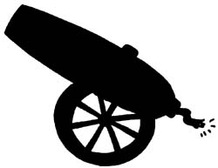
F = 5 N
v = 300 m/s
25º

Slide 79

v_{i} = 0.7 m/s
3 kg
v_{f} = 0.3 m/s
2m
3 kg
$$θ=?$$

Slide 80
2 m

Slide 81


12 m
$$\dot{r}=−.25\frac{m}{s}$$
$$\dot{θ}= .5\frac{rad}{s}$$

Slide 82
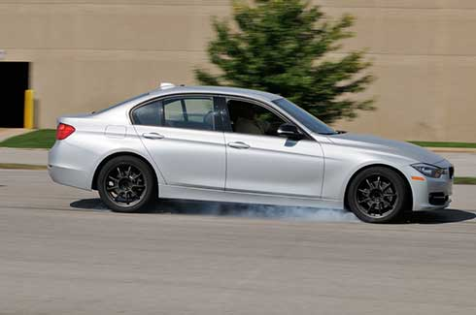

Slide 83
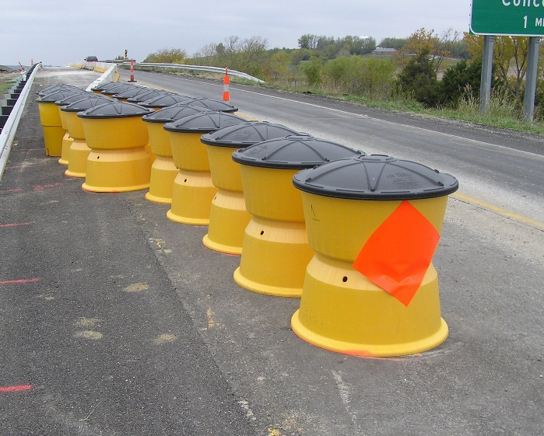
20 ft
40 ft
20,000 lbs
Force (lbs)
10,000 lbs
Distance
(ft)

Slide 84
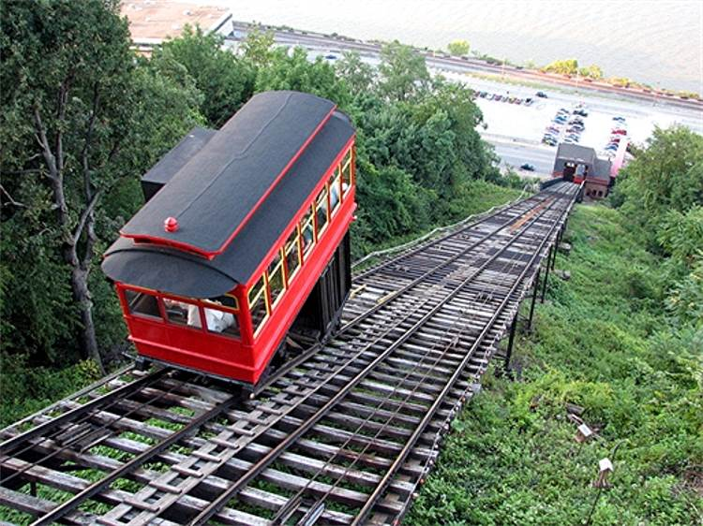

Slide 85
600 N
400 N
Force (N)
Distance
(m)
3 m

Slide 86
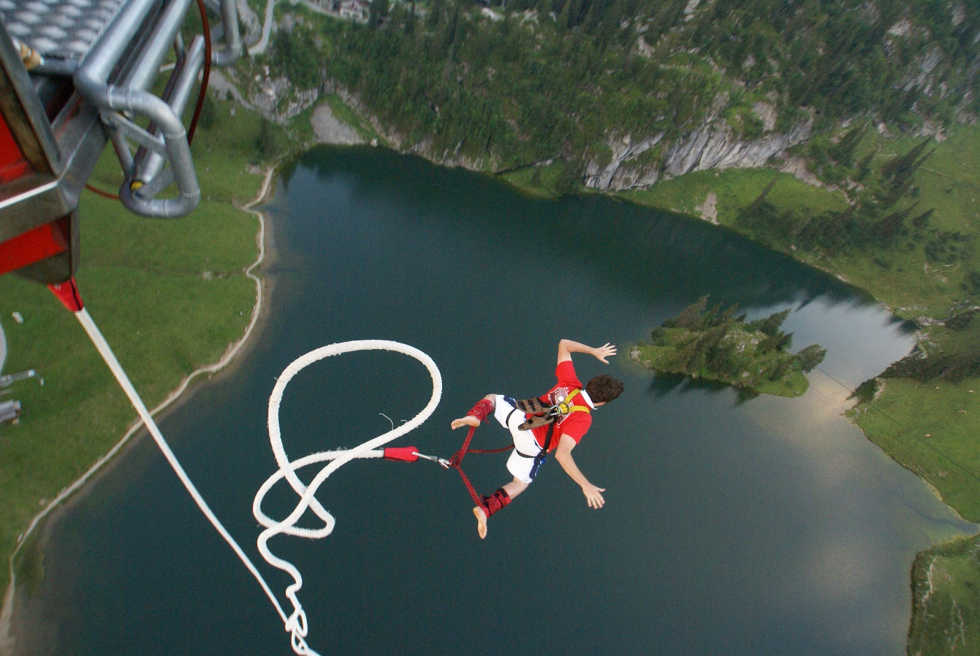

Slide 87
20 kg

Slide 88
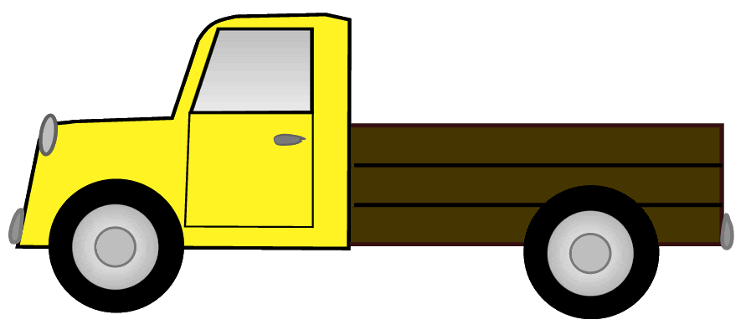
1100 kg
4 m
100 kg
5 m

Slide 89
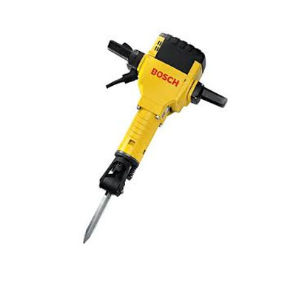
60 kN
30 kN
Force (kN)
Time
(ms)
3 ms

Slide 90


$$v_{o}=1200\frac{m}{s}$$
15º
$$v_{f}=1200\frac{m}{s}$$

Slide 91
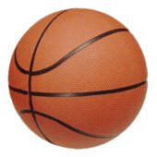
V_{f} = ?
V_{i} = 3 ft/s
Θ = ?
25º

Slide 92
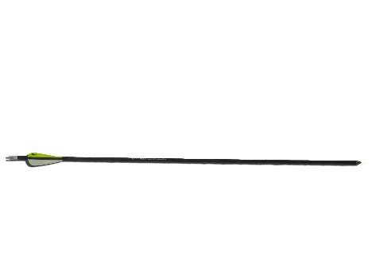

.05 lbs
350 ft/s
.4 lbs
3 ft
d

Slide 93

$$v_{Ai}=1.8 \frac{m}{s}$$
A
4 kg
B
1.5 kg

Slide 94
n
t
A
4 kg
45º
V_{i} = 5 m/s
B
2 kg

Slide 95
2 m
1.5 m
A
C
V_{out} = 600 m/s
COM
V_{in} = 80 m/s
30º
B
D

Slide 96
A
40º

Slide 97
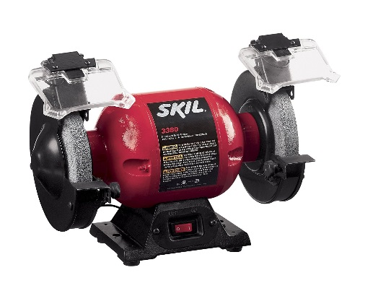

Slide 98
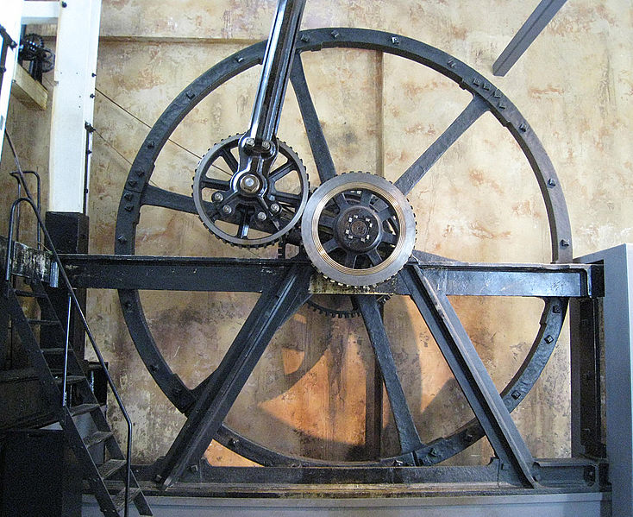
3 s
4 s
5 s
6 rad/s
Angular Velocity
(rad/s)
Time
(s)
Image by Newtown Graffiti CC-BY-2.0

Slide 99
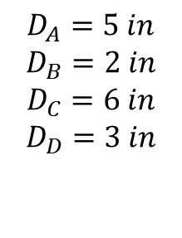

C
$$D_{A}=5 in$$
$$D_{B}=2 in$$
$$D_{C}=6 in$$
$$D_{D}=3 in$$
B
A
D
$$ω_{A}=60\frac{rad}{s}$$

Slide 100
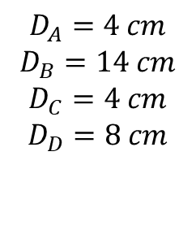

$$D_{A}=4 cm$$
$$D_{B}=14 cm$$
$$D_{C}=4 cm$$
$$D_{D}=8 cm$$
B
D
A
C
$$ω_{A}=2500 rpm$$

Slide 101




B
$$L_{AB}=L_{BC}=2 m$$
$$65°$$
$$65°$$
C
$$v=1.5 m/s$$
A

Slide 102
v = 2 m/s
a = 5 m/s²
400 mm
150 mm

Slide 103





$$v_{c} = 2 m/s$$
$$A_{c}= 5 m/s2$$
C
$$L_{BC}= 325 mm$$
B
A
$θ_{AB}= 20o$
$$L_{AB}=200 mm$$

Slide 104
1 m
1 m
20º
1.5 m

Slide 105





$$ω_{BC}=4 rad/s$$
$$α_{BC}=−1 rad/s2$$
B
$$θ_{BC}=−30°$$
y
3 ft
C
2 ft
$$θ_{AB} = 65°$$
A
x
$$ω_{AB}=−2 rad/s$$

Slide 106




B
$$L_{AB}=1.2 m$$
$ω_{AB}= ?$
A
$θ_{AB}= ?$
$$v=30 m/s$$

Slide 107
4 ft
4 ft
2.5 ft
v = 90 ft/s

Slide 108

F_{thruster}
$$α=.1 rad/s^{2}$$
F_{thruster}

Slide 109
50 kg

Slide 110



$$v_{o}=0$$
$$v_{f}=25 m/s$$
F_{laucher}
50 cm

Slide 111
O
A
3 ft
30º
5 rad/s
3 rad/s
B
1 rad/s²
0 rad/s²
2 ft

Slide 112
5
.75 m
5 kg
x2
20 kg

Slide 113
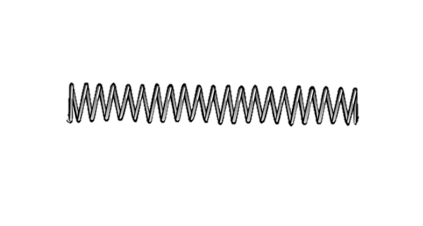
36 in
4 in
3 in

Slide 114
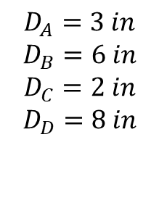

B
$$D_{A}=3 in$$
$$D_{B}=6 in$$
$$D_{C}=2 in$$
$$D_{D}=8 in$$
C
D
A
$$ω_{A}=60\frac{rad}{s}$$

Slide 115
600 rpm
F_{brake}

Slide 116

F_{thruster}
$$ω_{f}=?$$
F_{thruster}

Slide 117
y
2 m
5 m
2 m

Slide 118
40 cm
10 cm

Slide 119
1.5 m/s
B
35º
C
A

Slide 120

2m
20, 000 kg
4 m
200 m/s
3 kg
10 m

Slide 121
y
800 N
60º
x

Slide 122
y
6 kN
25º
x
130º
z

Slide 123
y
O
x
8 in
z
T = 80 lbs
9 in
12 in
A

Slide 124
y
60 lbs
60º
x
20º
30 lbs

Slide 125
y
F₁ = 400 N
40º
F_{R} = 600 N
x
?
F₂ = ?

Slide 126

y
$$y=−\frac{1}{2}x^{2}+8$$
8 cm
x
4 cm

Slide 127
y
3 in
10 in
x
8 in

Slide 128
8 ft
Z
4 ft
Y
X
4 ft

Slide 129
y
2 in
1.5 in
.5 in
2 in
1.5 in
x
.5 in

Slide 130
Y
r = 6 in
X
O

Slide 131
Y
X
4 in
r = 1.5 in
4 in

Slide 132
6 cm
1 cm
6 cm

Slide 133
y
5 m
3 m
5 m

Slide 135
6 in
2 in
0.5 in

